Slide 1
A SLEEP TRACKING APP FOR BETTER NIGHT’S REST
TEAM MEMBERS
715522244026 - MATHUKRISHNA T S
715522244033 - PARTHIPAN S
715522244041 - RITHANYA S
715522244042 - RITHIK P
715522244055 - VIBISHA S

Slide 2
DESCRIPTION
A sleep-tracking app is a tool or system designed to monitor and record sleep patterns, specifically focusing on sleep timings. It serves as a useful resource for individuals looking to improve their sleep quality by providing insights into their sleep duration and consistency.
Sleep Timer: The primary feature of the app, the sleep timer, records the start and end times of each sleep session. Users can manually input these times or start and stop the timer as they fall asleep and wake up.
Sleep Log: This is a digital record where each sleep session is documented, including the exact times users went to bed and woke up. The log provides a clear overview of sleep habits over time, helping users identify trends in their sleep schedule.
Sleep Analysis: The app provides basic analysis of sleep timings, highlighting patterns like average sleep duration and bedtime consistency. This helps users track their progress in maintaining a regular sleep schedule.
Mobile App: Available as a mobile application, the sleep tracker is designed for ease of use. It allows users to check and update their sleep data on the go, making it convenient to keep track of sleep habits daily.
Reports: Users can view simple reports and summaries of their sleep data, which visually display weekly and monthly sleep patterns. This feature assists users in understanding their sleep trends and making adjustments as needed.
Reminders: To encourage better sleep routines, the app can send gentle reminders to prompt users to go to bed at a consistent time. This feature supports building a regular sleep schedule, essential for healthy sleep hygiene.

Slide 3
Main Activity.kt:
package com.example.projectone
import android.content.Context
import android.content.Intent
import android.icu.text.SimpleDateFormat
import android.os.Bundle
import androidx.activity.ComponentActivity
import androidx.activity.compose.setContent
import androidx.compose.foundation.Image
import androidx.compose.foundation.layout.*
import androidx.compose.foundation.shape.RoundedCornerShape
import androidx.compose.material.Button
import androidx.compose.material.MaterialTheme
import androidx.compose.material.Surface
import androidx.compose.material.Text
import androidx.compose.runtime.*
import androidx.compose.ui.Alignment
import androidx.compose.ui.Modifier
import androidx.compose.ui.draw.alpha
import androidx.compose.ui.graphics.Color
import androidx.compose.ui.layout.ContentScale

Slide 4
import androidx.compose.ui.res.painterResource
import androidx.compose.ui.unit.dp
import androidx.compose.ui.unit.sp
import androidx.core.content.ContextCompat
import com.example.projectone.ui.theme.ProjectOneTheme
import java.util.*
class MainActivity : ComponentActivity() {
private lateinit var databaseHelper: TimeLogDatabaseHelper
override fun onCreate(savedInstanceState: Bundle?) {
super.onCreate(savedInstanceState)
databaseHelper = TimeLogDatabaseHelper(this)
databaseHelper.deleteAllData()
setContent {
ProjectOneTheme {
Surface(
modifier = Modifier.fillMaxSize(),
color = MaterialTheme.colors.background
) {
MyScreen(this, databaseHelper)
}
}

Slide 5
}
}
}
@Composable
fun MyScreen(context: Context, databaseHelper: TimeLogDatabaseHelper) {
var startTime by remember { mutableStateOf(0L) }
var isRunning by remember { mutableStateOf(false) }
var elapsedTime by remember { mutableStateOf(0L) }
val imageModifier = Modifier
Image(
painterResource(id = R.drawable.sleeptracking),
contentScale = ContentScale.FillHeight,
contentDescription = "",
modifier = imageModifier.alpha(0.7F)
)
LaunchedEffect(isRunning) {
if (isRunning) {
while (isRunning) {

Slide 6
Button(
onClick = {
startTime = System.currentTimeMillis()
isRunning = true
},
shape = RoundedCornerShape(12.dp),
modifier = Modifier
.fillMaxWidth()
.padding(horizontal = 32.dp)
) {
Text(text = "Start", fontSize = 18.sp)
}
} else {
Button(
onClick = {
val endTime = System.currentTimeMillis()
isRunning = false
databaseHelper.addTimeLog(endTime, startTime)
},
shape = RoundedCornerShape(12.dp),
modifier = Modifier
.fillMaxWidth()
.padding(horizontal = 32.dp)
) {

Slide 7
Text(text = "Stop", fontSize = 18.sp)
}
}
Spacer(modifier = Modifier.height(24.dp))
// Display elapsed time as HH:mm:ss format
Text(
text = formatTime(elapsedTime),
fontSize = 32.sp,
color = Color.White,
modifier = Modifier.padding(top = 16.dp)
)
Spacer(modifier = Modifier.height(24.dp))
Button(
onClick = {
context.startActivity(
Intent(context, TrackActivity::class.java)
)
},

Slide 8
shape = RoundedCornerShape(12.dp),
modifier = Modifier
.fillMaxWidth()
.padding(horizontal = 32.dp)
) {
Text(text = "Track Sleep", fontSize = 18.sp)
}
}
}
private fun formatTime(timeInMillis: Long): String {
val hours = (timeInMillis / (1000 * 60 * 60)) % 24
val minutes = (timeInMillis / (1000 * 60)) % 60
val seconds = (timeInMillis / 1000) % 60
return String.format("%02d:%02d:%02d", hours, minutes, seconds)
}
private fun startTrackActivity(context: Context) {
val intent = Intent(context, TrackActivity::class.java)
ContextCompat.startActivity(context, intent, null)
}
fun getCurrentDateTime(): String {
val dateFormat = SimpleDateFormat("yyyy-MM-dd HH:mm:ss", Locale.getDefault())

Slide 9
val dateFormat = SimpleDateFormat("yyyy-MM-dd HH:mm:ss", Locale.getDefault())
val currentTime = System.currentTimeMillis()
return dateFormat.format(Date(currentTime))
}
Login Activity.kt:
package com.example.projectone
import android.content.Context
import android.content.Intent
import android.os.Bundle
import androidx.activity.ComponentActivity
import androidx.activity.compose.setContent
import androidx.compose.foundation.Image
import androidx.compose.foundation.layout.*
import androidx.compose.material.*
import androidx.compose.runtime.*
import androidx.compose.ui.Alignment
import androidx.compose.ui.Modifier
import androidx.compose.ui.draw.alpha
import androidx.compose.ui.graphics.Color
import androidx.compose.ui.layout.ContentScale

Slide 10
import androidx.compose.ui.res.painterResource
import androidx.compose.ui.text.font.FontFamily
import androidx.compose.ui.text.font.FontWeight
import androidx.compose.ui.unit.dp
import androidx.compose.ui.unit.sp
import androidx.core.content.ContextCompat
import com.example.projectone.ui.theme.ProjectOneTheme
class LoginActivity : ComponentActivity() {
private lateinit var databaseHelper: UserDatabaseHelper
override fun onCreate(savedInstanceState: Bundle?) {
super.onCreate(savedInstanceState)
databaseHelper = UserDatabaseHelper(this)
setContent {
ProjectOneTheme {
Surface(
modifier = Modifier.fillMaxSize(),
color = MaterialTheme.colors.background
) {
LoginScreen(this, databaseHelper)
}
}
}
}

Slide 11
@Composable
fun LoginScreen(context: Context, databaseHelper: UserDatabaseHelper) {
var username by remember { mutableStateOf("") }
var password by remember { mutableStateOf("") }
var error by remember { mutableStateOf("") }
val imageModifier = Modifier
Image(
painterResource(id = R.drawable.sleeptracking),
contentScale = ContentScale.FillHeight,
contentDescription = "",
modifier = imageModifier
.alpha(0.3F),
)
Column(
modifier = Modifier.fillMaxSize(),
horizontalAlignment = Alignment.CenterHorizontally,
verticalArrangement = Arrangement.Center
) {
Image(
painter = painterResource(id = R.drawable.sleep),
contentDescription = "",

Slide 12
modifier = imageModifier
.width(260.dp)
.height(200.dp)
)
Text(
fontSize = 24.sp,
fontWeight = FontWeight.SemiBold,
fontFamily = FontFamily.SansSerif,
color = Color.Black,
text = "Login"
)
Spacer(modifier = Modifier.height(10.dp))
TextField(
value = username,
onValueChange = { username = it },
label = { Text("Username") },
modifier = Modifier
.padding(10.dp)
.width(280.dp)
)

Slide 13
TextField(
value = password,
onValueChange = { password = it },
label = { Text("Password") },
modifier = Modifier
.padding(10.dp)
.width(280.dp)
)
if (error.isNotEmpty()) {
Text(
text = error,
color = MaterialTheme.colors.error,
modifier = Modifier.padding(vertical = 16.dp)
)
}
Button(
onClick = {
if (username.isNotEmpty() && password.isNotEmpty()) {
val user = databaseHelper.getUserByUsername(username)
if (user != null && user.password == password) {
error = "Login Successfull 👍"
context.startActivity(

Slide 14
Intent(
context,
MainActivity::class.java
)
)
} else {
error = "Invalid username or password"
}
} else {
error = "Enter all the fields"
}
},
modifier = Modifier
.padding(top = 16.dp)
.width(280.dp)
) {
Text(text = "Login")
}
// Signup button below the Login button
Button(
onClick = {
context.startActivity(
Intent(

Slide 15
context,
MainActivity2::class.java
)
)
},
modifier = Modifier
.padding(top = 16.dp)
.width(280.dp)
) {
Text(text = "Sign up")
}
}
}
private fun startMainPage(context: Context) {
val intent = Intent(context, MainActivity2::class.java)
ContextCompat.startActivity(context, intent, null)
}

Slide 16
Registration Activity.kt
package com.example.projectone
import android.content.Context
import android.content.Intent
import android.os.Bundle
import androidx.activity.ComponentActivity
import androidx.activity.compose.setContent
import androidx.compose.foundation.Image
import androidx.compose.foundation.layout.*
import androidx.compose.material.*
import androidx.compose.runtime.*
import androidx.compose.ui.Alignment
import androidx.compose.ui.Modifier
import androidx.compose.ui.draw.alpha
import androidx.compose.ui.graphics.Color
import androidx.compose.ui.layout.ContentScale
import androidx.compose.ui.res.painterResource
import androidx.compose.ui.text.font.FontFamily
import androidx.compose.ui.text.font.FontWeight

Slide 17
import androidx.compose.ui.unit.dp
import androidx.compose.ui.unit.sp
import androidx.core.content.ContextCompat
import com.example.projectone.ui.theme.ProjectOneTheme
class MainActivity2 : ComponentActivity() {
private lateinit var databaseHelper: UserDatabaseHelper
override fun onCreate(savedInstanceState: Bundle?) {
super.onCreate(savedInstanceState)
databaseHelper = UserDatabaseHelper(this)
setContent {
ProjectOneTheme {
// A surface container using the 'background' color from the theme
Surface(
modifier = Modifier.fillMaxSize(),
color = MaterialTheme.colors.background
) {
RegistrationScreen(this,databaseHelper)
}
}
}
}
}

Slide 18
@Composable
fun RegistrationScreen(context: Context, databaseHelper: UserDatabaseHelper) {
var username by remember { mutableStateOf("") }
var password by remember { mutableStateOf("") }
var email by remember { mutableStateOf("") }
var error by remember { mutableStateOf("") }
val imageModifier = Modifier
Image(
painterResource(id = R.drawable.sleeptracking),
contentScale = ContentScale.FillHeight,
contentDescription = "",
modifier = imageModifier
.alpha(0.3F),
)
Column(
modifier = Modifier.fillMaxSize(),
horizontalAlignment = Alignment.CenterHorizontally,
verticalArrangement = Arrangement.Center
) {
Image(
painter = painterResource(id = R.drawable.sleep),
contentDescription = "",

Slide 19
modifier = imageModifier
.width(260.dp)
.height(200.dp)
)
Text(
fontSize = 36.sp,
fontWeight = FontWeight.ExtraBold,
fontFamily = FontFamily.Cursive,
color = Color.White,
text = "Register"
)
Spacer(modifier = Modifier.height(10.dp))
TextField(
value = username,
onValueChange = { username = it },
label = { Text("Username") },
modifier = Modifier
.padding(10.dp)
.width(280.dp)
)

Slide 20
TextField(
value = email,
onValueChange = { email = it },
label = { Text("Email") },
modifier = Modifier
.padding(10.dp)
.width(280.dp)
)
TextField(
value = password,
onValueChange = { password = it },
label = { Text("Password") },
modifier = Modifier
.padding(10.dp)
.width(280.dp)
)
if (error.isNotEmpty()) {
Text(
text = error,
color = MaterialTheme.colors.error,

Slide 21
modifier = Modifier.padding(vertical = 16.dp)
)
}
Button(
onClick = {
if (username.isNotEmpty() && password.isNotEmpty() && email.isNotEmpty()) {
val user = User(
id = null,
firstName = username,
lastName = null,
email = email,
password = password
)
databaseHelper.insertUser(user)
error = "User registered successfully"
// Start LoginActivity using the current context
context.startActivity(
Intent(
context,
LoginActivity::class.java
)
)

Slide 22
} else {
error = "Please fill all fields"
}
},
modifier = Modifier.padding(top = 16.dp)
) {
Text(text = "Register")
}
Spacer(modifier = Modifier.width(10.dp))
Spacer(modifier = Modifier.height(10.dp))
Row() {
Text(
modifier = Modifier.padding(top = 14.dp), text = "Have an account?"
)
TextButton(onClick = {
})
{
Spacer(modifier = Modifier.width(10.dp))
Text(text = "Log in")
}
}

Slide 23
private fun startLoginActivity(context: Context) {
val intent = Intent(context, LoginActivity::class.java)
ContextCompat.startActivity(context, intent, null)
}

Slide 24
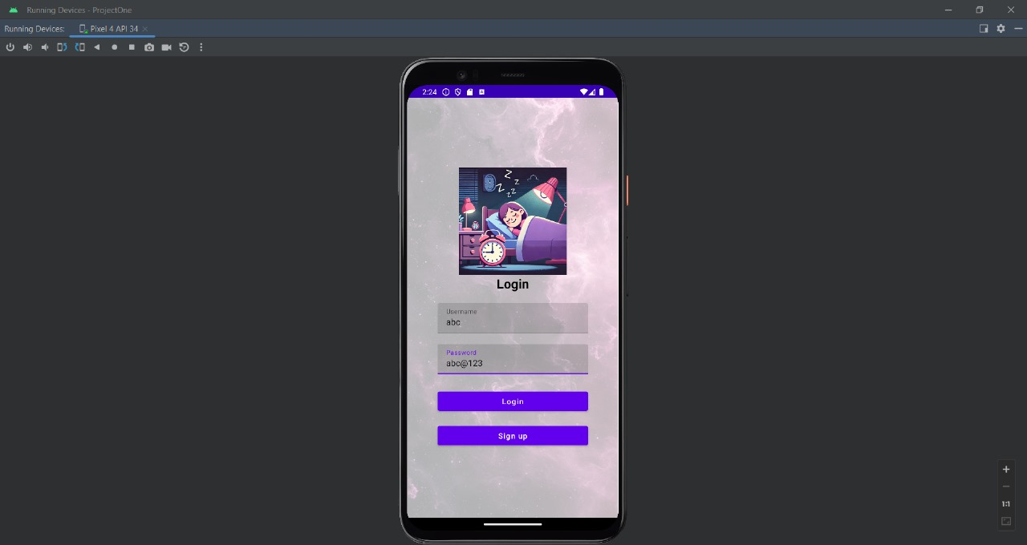
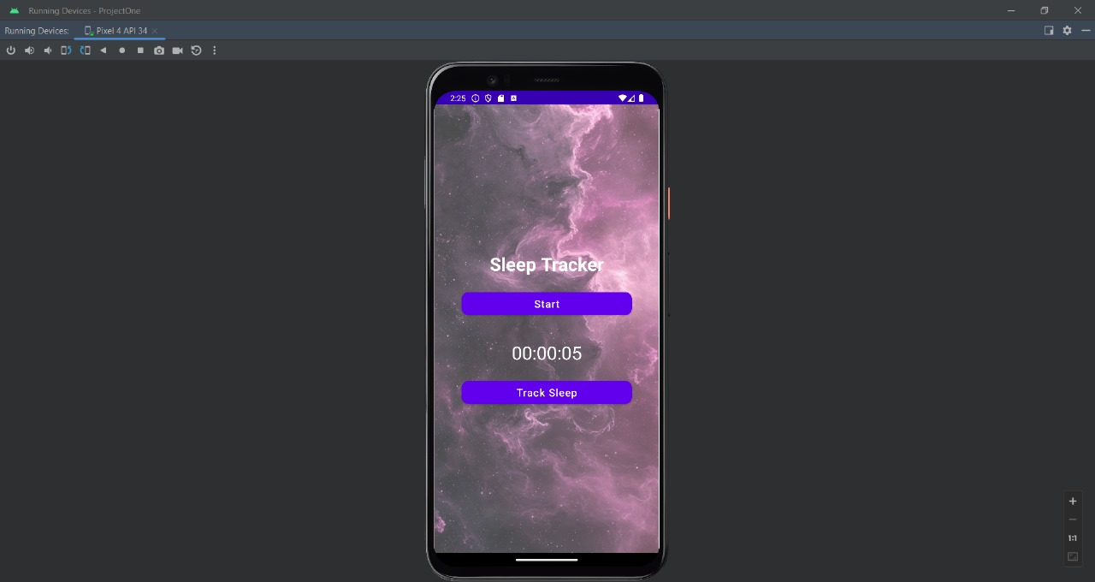
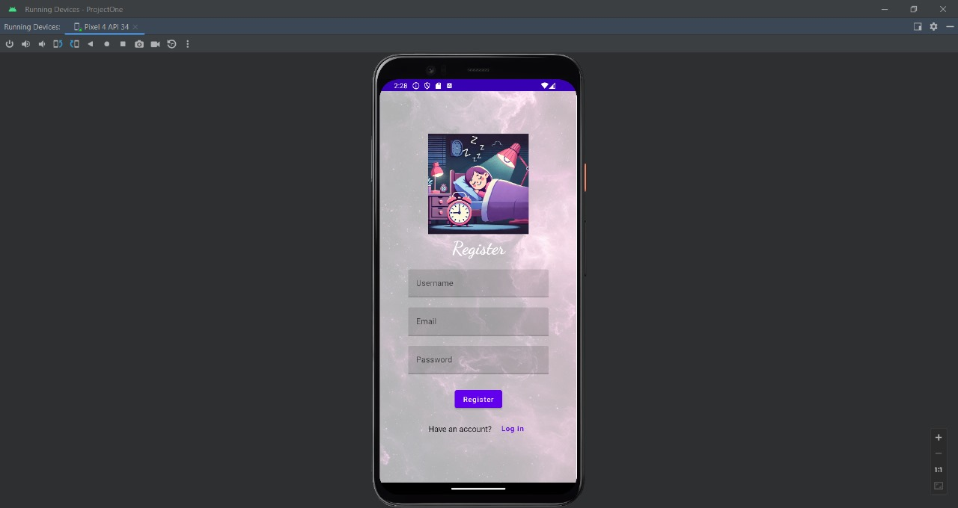
OUTPUT :

Slide 25

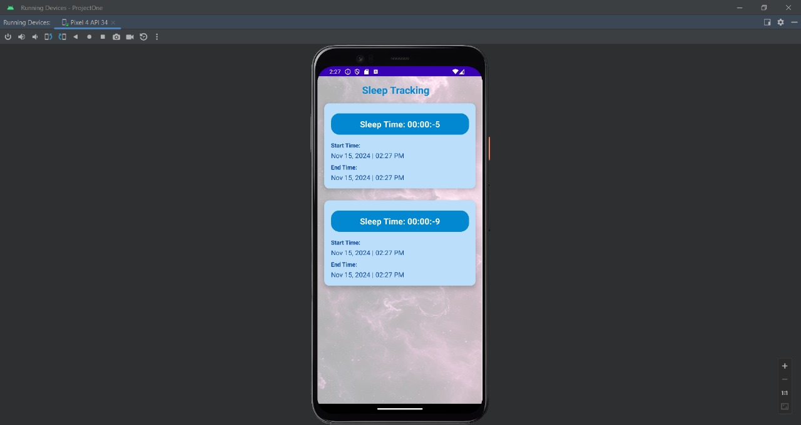
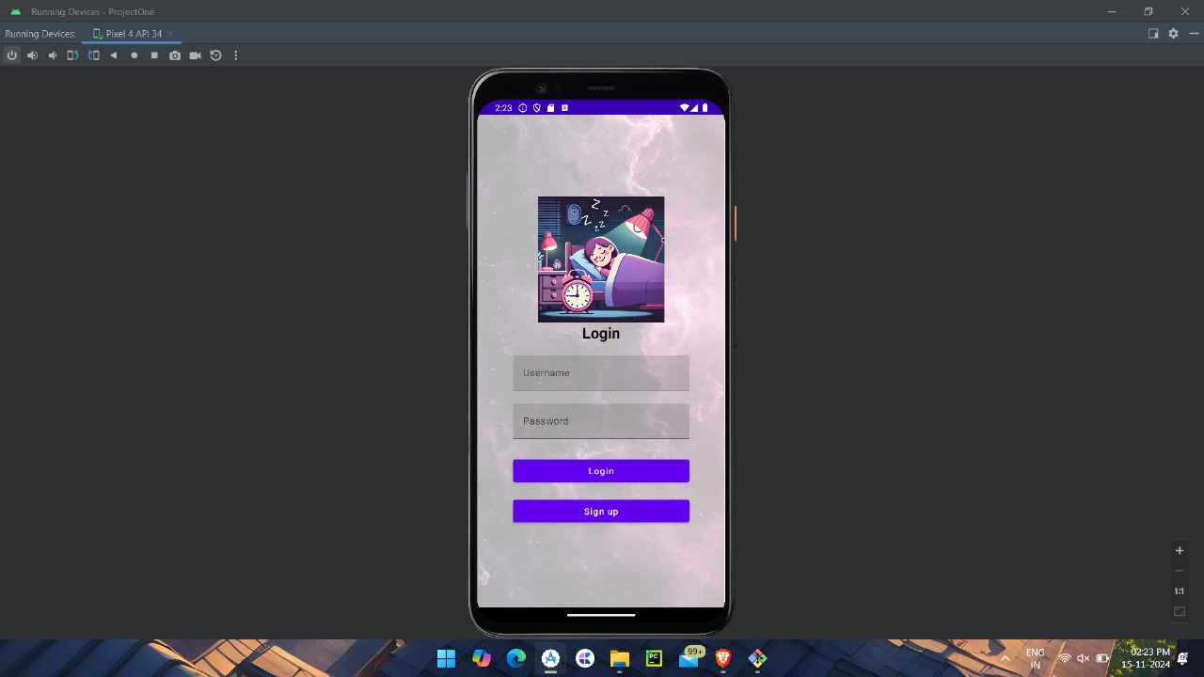

Slide 26
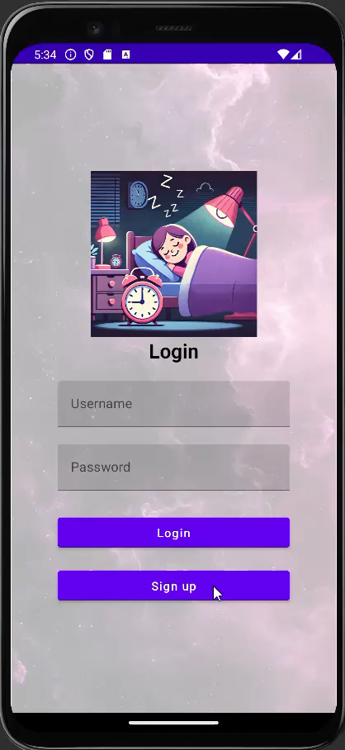
DEMO OF THE PROJECT :

